Slide 1
Search Engines and Applications
Prof. Dik Lun Lee

Slide 2
Search Engines is Older Than you Thought
It has many names:
Information retrieval (IR) – from 50’s
Document retrieval – from 60’s
Text retrieval – from 70’s
and applications:
Digital libraries
Web search
Vertical search (e.g., e-commerce)

Slide 3
What Kind of Data does IR Deal With?
Unformatted or unstructured data (as opposed to relational database)
Textual data: papers, technical reports, newspaper articles
Completed untagged, plain-text data
Semi-structured data
Web pages (HTML and XML files)
Email messages
Non-textual data
images, graphics, video
In this course, we study textual and web data

Slide 4
Examples of IR Systems :
Search Engines are not just Google, Bing, Baidu (GBB)
These are global, web-scale search engines
Most people used IR in some other ways, e.g.,
Library catalogue search; most library search systems support both structured and full text search
Amazon’s product search
Many others (Wikipedia search, …)
Notes:
To search for “information retrieval”, you must start with the first character, I.e., you can search ‘i’, ‘info’, ‘information’, etc., but you cannot just search ‘retrieval’. Easy to implement, because the system only needs to maintain a list of sorted course titles.
Answerbook: searches keywords withink title (and perhaps abstract too), but no full-text search
Search sophication, search scope, etc., affect the cost of implementation

Slide 5
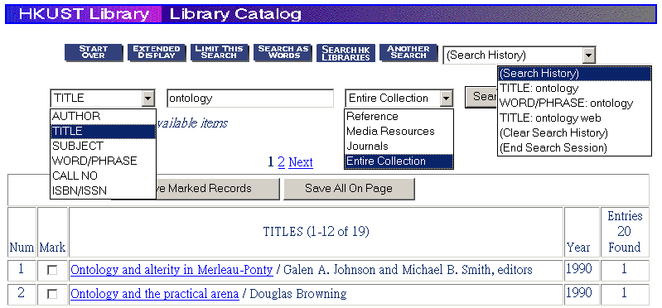
Library systems
Books: http://ustlib.ust.hk/ (HKUST library)
Federated search
Notes:
To search for “information retrieval”, you must start with the first character, I.e., you can search ‘i’, ‘info’, ‘information’, etc., but you cannot just search ‘retrieval’. Easy to implement, because the system only needs to maintain a list of sorted course titles.
Answerbook: searches keywords withink title (and perhaps abstract too), but no full-text search
Search sophication, search scope, etc., affect the cost of implementation

Slide 6

Result Page has more Functions
Unlike Google, libraries have more structured data (fields / facets)
Notes:
To search for “information retrieval”, you must start with the first character, I.e., you can search ‘i’, ‘info’, ‘information’, etc., but you cannot just search ‘retrieval’. Easy to implement, because the system only needs to maintain a list of sorted course titles.
Answerbook: searches keywords withink title (and perhaps abstract too), but no full-text search
Search sophication, search scope, etc., affect the cost of implementation

Slide 7
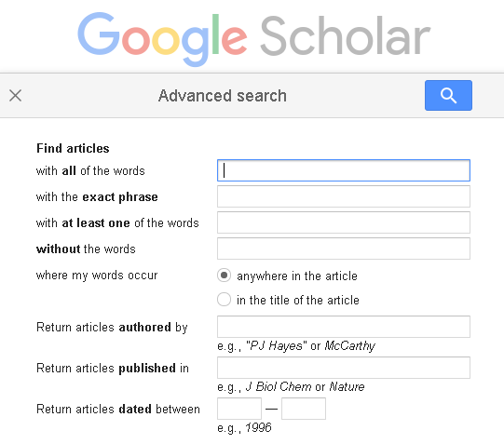
How is it Compared to Google Scholar?
Boolean conditions on keywords
Field search

Slide 8
Site Search
A search engine for one site (or group of related sites)
How is it different from GBB?
Data are more structured:
Data are grouped into "collections “, e.g., products, press releases, news, manuals, records dumped from database tables
Search can be applied to a subset of the collections
Query format:
Standard AND/OR, phrase, etc.
Search on fields: titles, authors, within date range, etc.
Result page: Grouped by document types, ranked by date or relevance, etc.
Example: search on amazon.com; what search features are most useful to you that are available on GBB?
Notes:
To search for “information retrieval”, you must start with the first character, I.e., you can search ‘i’, ‘info’, ‘information’, etc., but you cannot just search ‘retrieval’. Easy to implement, because the system only needs to maintain a list of sorted course titles.
Answerbook: searches keywords withink title (and perhaps abstract too), but no full-text search
Search sophication, search scope, etc., affect the cost of implementation

Slide 9
Embedded Search Engines on Devices
Media and devices that come with a search engine
A CD/DVD may contain a large amount of data (e.g., conference proceedings); a search engine embedded on it allows you to search the content immediately
E.g., Electronic encyclopaedia, product catalogues, corporate reports, etc.
Search engines embedded on IOT devices
What in this world is going to generate the largest amount of data?
Special requirements:
Tailored for the data and device
No user installation needed; built-in and executable
Provide adequate human/machine and machine/machine interfaces
Fast and resource sensitive (running on small devices)
Notes:
To search for “information retrieval”, you must start with the first character, I.e., you can search ‘i’, ‘info’, ‘information’, etc., but you cannot just search ‘retrieval’. Easy to implement, because the system only needs to maintain a list of sorted course titles.
Answerbook: searches keywords withink title (and perhaps abstract too), but no full-text search
Search sophication, search scope, etc., affect the cost of implementation

Slide 10
How do you Search for Files on UNIX/LINUX?
UNIX grep commands (grep, egrep, agrep, etc.)
$ grep comp4321 input-file1 input-file2 …
Input files
Matched lines
in input files
grep
Query = comp4321
man –k keyword
Search UNIX man pages
Perform (regular expression) pattern matching

Slide 11
How do you Search for Files on Windows?
Search for files: plain text, MS Office files, email, etc.
Specify filenames, dates, file types, etc.
Windows built-in search function

Slide 12
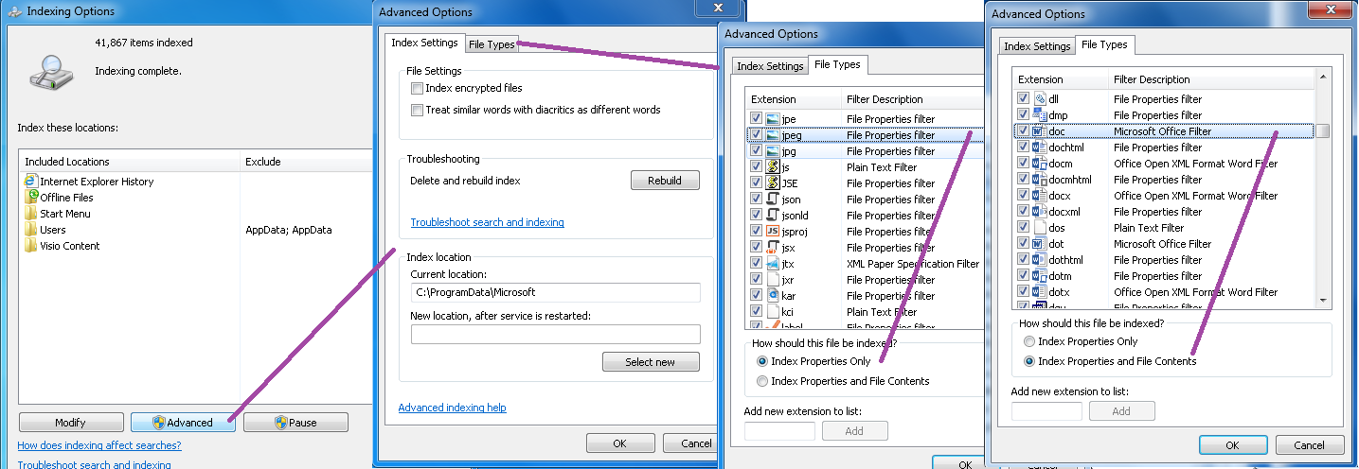
Index/Search on Windows 10
Windows 10 Index Option allows you to specify:
Folders to index
Index encrypted files or not
To index properties only or properties plus content for different file types
Rebuild index at any time

Slide 13
Web Search Engines (GBB: Google/Bing/Baidu)
World wide web search engines: we will cover them a lot
Most popular IR application nowadays, e.g., Google, Bing, Baidu
Other niche search engine DuckDuckGo, Yandex, etc.
Spider / Crawler
Index
Search
engine
User
queries
Web pages
Local
copy
Cache
In a real
implementation
Notes:
To search for “information retrieval”, you must start with the first character, I.e., you can search ‘i’, ‘info’, ‘information’, etc., but you cannot just search ‘retrieval’. Easy to implement, because the system only needs to maintain a list of sorted course titles.
Answerbook: searches keywords withink title (and perhaps abstract too), but no full-text search
Search sophication, search scope, etc., affect the cost of implementation

Slide 14

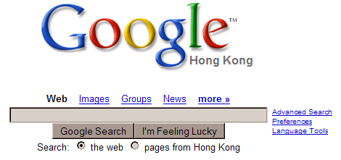





Google, Bing, Baidu
Notes:
To search for “information retrieval”, you must start with the first character, I.e., you can search ‘i’, ‘info’, ‘information’, etc., but you cannot just search ‘retrieval’. Easy to implement, because the system only needs to maintain a list of sorted course titles.
Answerbook: searches keywords withink title (and perhaps abstract too), but no full-text search
Search sophication, search scope, etc., affect the cost of implementation

Slide 15
Why is IR Important?
Most information available is in textual form and has no predefined format (e.g., emails and articles)
You may think businesses store data in structured databases, but >80% of business information is unstructured and mostly in text
Integration of text retrieval capability in most relational database systems. SQL already supports limited search capability such as search based on regular expressions:
select * from Employee where Name like ’%Lee%’
Increasing number of online documentation systems (no more hardcopy!)
Of course, the bloom of World Wide Web

Slide 16
Why is IR a Difficult Problem?
The size of the web is doubling every year:
50 million pages in November 1995
320 million pages in December 1997
800 million pages in February 1999
1 billion pages in 2000
3.5 billion in 2003 (openfind.com)
8 billion in 2004 (google.com)
20+ billion in 2005 (yahoo.com)
Google stopped releasing the size
130 trillion in 2016
Huge amount of data (e.g., WWW) dictates efficiency, effectiveness and user-friendliness
Imagine spending “just 0.1 seconds on each page!
Renders Natural Language Processing infeasible
Google has an estimated 900,000 servers, and each query triggers >1000 servers (2011 data)

Slide 17
Why is IR a Difficult Problem? (Cont.)
Unstructured data: difficult to capture semantics in documents. Compare:
“select * from Employee where Salary > 100,000”
“retrieve all news items about corporate takeover”
Why is the second query more difficult to answer? The following query is even more difficult:
“retrieve all news items about corporate takeover involving an internet company”
Note: syntactic → semantic → real-world knowledge
Documents have unrestricted subject domains
it is hard to predefine or pre-categorize the subject domains of documents

Slide 18
Why is IR a Difficult Problem? (Cont.)
Diversified user base: expert to casual users
a system may be clumsy for an expert user but difficult to use for a casual user
a system may return information too general to be useful for an expert in the subject but too narrow for a general user
Intention of information and user query is hard to capture
compare a README file and a user manual
compare a summary versus an in-depth report
One size cannot fit all!

Slide 19
Why is IR a Difficult Problem?
Distributed and interlinked (e.g., Hypertext and WWW)
Where to start a search? Unlike in a centralize database, you have only one (or a few) database(s) to search.
How are the information related?
How fast
How good
Efficiency vs. effectiveness
With a limited amount of resources, one can only improve efficiency and effectiveness to a certain degree. Moreover, improving efficiency often means degrading effectiveness, and vice versa.

Slide 20
Document Retrieval Model
Relevance Feedback
User’s information need
Query formulation
Retrieved
documents
Document modification
Documents
Formal language
retrieval
Document representation
Indexing
Document: a long string of characters contained in a single file
Index: a list of important keywords from the documents, stored in some efficient file structure
Query: Boolean (A and B or C), list of words, natural language
Relevance feedback: try “similar pages” in Google

Slide 21
Evolution of Search Technologies
Zeroth-generation search (1960 -)
Libraries, collections of electronic documents (legal documents, Lexis/Nexis, scientific databases)
Individual documents organized in folders or databases
Keyword-based search (looking for keywords)
Search on fields (title, author, date) in addition to search on full text body
Boolean (title=“computer” AND body contains “IBM”)
E.g., IBM Stairs
0.5 generation: adding statistical to Boolean (e.g., how often does a keyword appear in a document and where?)

Slide 22
Evolution of Search Technologies (Cont.)
First-generation search engines (web-based, 1993 -)
Statistical keyword match
traditional search methods applied to web
Add a spider / crawler
Earlier versions:
Altavista (started by Digital Equipment Corporation, then the 2nd largest computer company; sold to Yahoo!)
Infoseek (founded in 1994; Infoseek engineer Li Yanhong returned to China and founded Baidu; sold to Disney in 1998)
Lycos (started by CMU in 1994)
etc.

Slide 23
Evolution of Search Technologies (Cont.)
Second-generation search engines (1997 - )
In addition to keyword matching, relying heavily on link analysis (thus capitalizing the special property of web)
Google, Fast (sold to Microsoft), etc. etc.

Slide 24
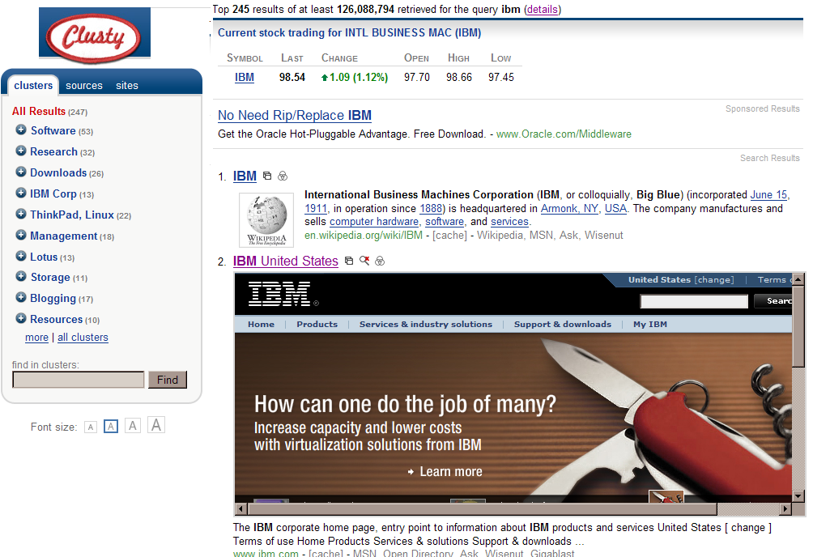
Evolution of Search Technologies (Cont.)
Third-generation search engines (2001- )
Incorporate advanced search features, e.g., automatic categorization
Challengers:
Teoma (acquired by ask.com)
Wisenut (acquired by Looksmart)
Vivisimo (own clusty.com; started by CMU in 2000; acquired by IBM)
Powerset (acquired by Microsoft in 2008 at allegedly US$ 100m)
Companies that you will start!

Slide 25
The Search Industry (and our Job Market)
Enterprise search
Companies deploy their own search engines to enhance the productivity of knowledge workers
Endeca (Oracle), Autonomy (Micro Focus), Lucene/Elasticsearch, Microsoft SharePoint/Fast, and Google/Azure Cloud Search, …
Classified and local search
Yellow/White page directories, recruitment and travel web sties; ad placement is the largest source of revenue (Craigslist, Openrice, …)
Search marketing
Companies offering search engine optimization (SEO) services to help websites ranking their pages high in search results
Notes:
To search for “information retrieval”, you must start with the first character, I.e., you can search ‘i’, ‘info’, ‘information’, etc., but you cannot just search ‘retrieval’. Easy to implement, because the system only needs to maintain a list of sorted course titles.
Answerbook: searches keywords withink title (and perhaps abstract too), but no full-text search
Search sophication, search scope, etc., affect the cost of implementation

Slide 26
Take Home Messages
Search engine is rooted in “information retrieval” used by academics
IR existed even before computers were invented (e.g., manual catalogs in libraries)
Search engine does NOT just mean web search (Google.com and Bing.com), it includes intranet and enterprise search engines
Search engine could search structured information (as in library systems)
Search engine is difficult primarily because it has to “understand” what the user wants through a few query keywords and the semantic content of the pages
Scaling up/out is also important
Notes:
To search for “information retrieval”, you must start with the first character, I.e., you can search ‘i’, ‘info’, ‘information’, etc., but you cannot just search ‘retrieval’. Easy to implement, because the system only needs to maintain a list of sorted course titles.
Answerbook: searches keywords withink title (and perhaps abstract too), but no full-text search
Search sophication, search scope, etc., affect the cost of implementation

Slide 27
Exercise: Identify Differences between Web Search and Structured Data?
 | Product search (e.g., amazon.com) | Public web search (e.g., google.com)
Types of content | Mostly structured data (authors, titles, etc.) and some unstructured data (reviews) | Most unstructured data (web page content) and some structured data (last modified date, filetype, etc.)
Query functions | ??? | ???
Search result refinement | ??? | ???
Notes:
To search for “information retrieval”, you must start with the first character, I.e., you can search ‘i’, ‘info’, ‘information’, etc., but you cannot just search ‘retrieval’. Easy to implement, because the system only needs to maintain a list of sorted course titles.
Answerbook: searches keywords withink title (and perhaps abstract too), but no full-text search
Search sophication, search scope, etc., affect the cost of implementation

